Slide 1
Board of Directors Training
Darrel James
Family & Community Engagement Manager
March 23, 2021

Slide 2
Family & Community Engagement
Family Advocates (8)
Family and Community Partnership
Health Services Coordinator
Medical, Dental, & Nutrition
Parent Engagement Coordinator
Parent Activities
Family Services Specialist
Transportation/ERSEA
Darrel J. James
Family & Community Engagement Manager

Slide 3
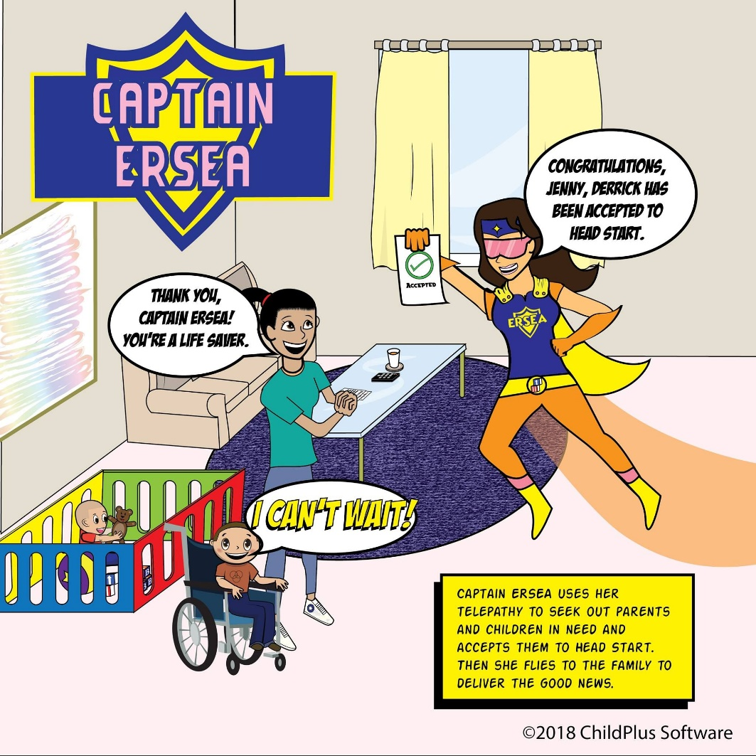
ERSEA Training Overview
Eligibility
Recruitment
Selection
Enrollment
Attendance

Slide 4
Purpose of ERSEA
Determine community strengths
Determine needs, resources, and recruitment areas
List requirements and procedures for the Eligibility, Recruitment, Selection, Enrollment and Attendance of children

Slide 5
Service Areas
Leon County - 327 slots
South City Head Start (188 slots)
Mabry Street Head Start (82 slots)
Louise B. Royal Head Start (57 slots)
Jefferson County – 34 slots
Jefferson County Head Start (34 slots)
Franklin County – 17 slots
Franklin County Head Start (17 slots)

Slide 6
Eligibility
In-person interview with each family
Application data is verified by qualified staff
Qualified staff will determine eligibility
Age requirements
Child must be 3 years old on or before September 1
Income
Family’s income must be equal to or below the poverty line
TANF, Homeless, SSI and Foster families are eligible

Slide 7
Eligibility
Families who meet eligibility requirements must be served first
A program may enroll an additional 35% of ineligible families
A program may enroll children with disabilities that are not income eligible

Slide 8
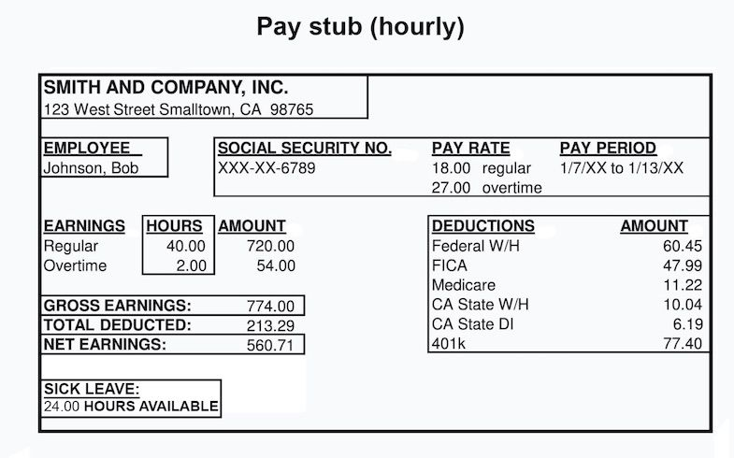
Verifying Eligibility
Tax forms (W-2, 1040)
Pay check stubs
Written statements from employers
Notarized Affidavit

Slide 9
Verifying Eligibility
Homeless Families
McKinney-Vento Homeless Act
Written statements from homeless service provider or school personnel
Signed declaration by the family
Foster Care Families
Court order
Any legal or government-issued document
Written statement from government child welfare official

Slide 10
Eligibility
Children are eligible for succeeding program year if age eligible
Program must keep eligibility records for each participant
Staff must be trained to determine eligibility of participants

Slide 11
Eligibility
Staff must not intentionally violate federal and program eligibility determination regulations
Program must train all governing body and Policy Council

Slide 12
Recruitment
Community Assessment Data
Recruitment Plan
Recruitment Area
Children with Disabilities
Early Head Start
Marketing
Social Media
Re-enrollment

Slide 13
Selection Process
ERSEA Committee
Selection Criteria
Program must meet 10% disability requirement
Wait List

Slide 14
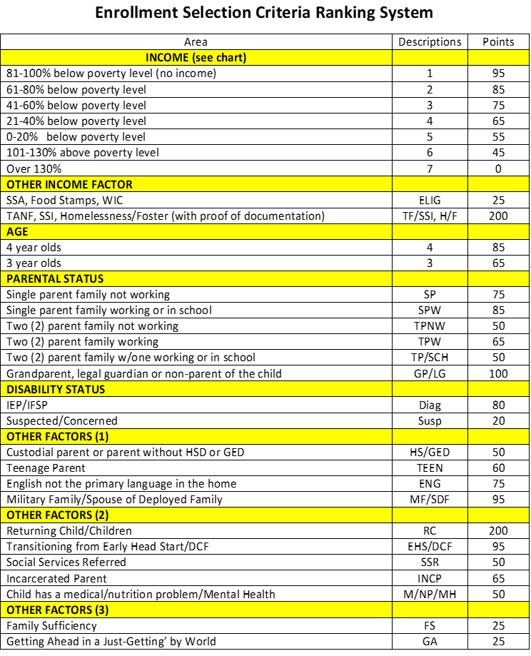

Slide 15
Enrollment
Funded Enrollment- 378
Program Reports to Office of Head Start
Vacancies
Homeless and Foster Care Children
Registration/DCF Rules
Parent Participation

Slide 16
Attendance
Tracking Attendance
One Hour Rule
Promote Regular Attendance
Average Daily Attendance

Slide 17
Thank You

