Slide 1
How to Implement

Slide 2
Overview
Implementing Getting Ahead/Staying Ahead
Budget
Getting Ahead
Recruitment
Forms
Best Practices
Staying Ahead
How it works

Slide 3
Notes:
-Investigators and co-investigators spend 15 straight wks @ 2-2.5 hrs a session investigating and researching poverty in the communities in which they reside , including individual choices, community conditions, exploitation, and political/economic structures.
-By investigating poverty and the contributing factors, we research and explore on a group level what needs to happen for us

Slide 4
What It Costs
How to Pay for It

Slide 5
Getting Ahead Budget
Orientation
Recruitment
Brochure/Flyer production | In-House
Screening document | In-House
Orientation
Meeting location | $75
Refreshments | $50
Subtotal | $125

Slide 6
Getting Ahead Budget
Workshops
Participant Workbook | 17 participants @ $16.50 per book | $281
Facilitator Workbook | 1 book @$18.50 per book | $19
Facility rental | 15 weeks @ $50/week | $750
Meals | 15 people for 15 weeks @$10/person | $2,250
Child Care | 2 people for 2.5/week for 15 weeks@$10/hour | $750
Supplies | Easel, flip charts, paper, pens, markers, portfolios, child care | $500
Stipend (Walmart Card) | $20 card for 15 people for 15 weeks | $4,500
Gas Cards | $20/ month for 3 people for 3 months (carpooling) | $180
Subtotal |  | $9,231

Slide 7
Getting Ahead Budget
Transition Ceremony
Venue |  | $200
Certificates and Frames | 15 certificates and frames | $30
Food (Caterer) | 50 Attendees @ $15/person + gratuity | $885
Subtotal |  | $1,115
Grand Total |  | $10,471
Note: Total does not include staff salary or travel costs.

Slide 8
Staying Ahead Budget
Orientation Plus Six Months
Recruitment (Invite to Transition Ceremony)
Mentor Application/Donation Form |  | In-House
Orientation
Meeting location |  | $75
Refreshments |  | $100
Subtotal |  | $175
Mentor Meetings
Meeting location | 6 weeks @ $75/wk | $450
Refreshments | 15 participants & 30 mentors @ $9/person | $405
Subtotal |  | $855
Grand Total |  | $1,030

Slide 9
Grand Total
$11,501

Slide 10
Recruit Recruit Recruit
Notes:
You want to recruit from colleges-Adult Education

Slide 11
Recruitment
Community Action clients….
Head Start parents
CareerSource – WIOA – Welfare to Work
Adult Education/Vocational Education
Social service agencies
Colleges
GED programs

Slide 12
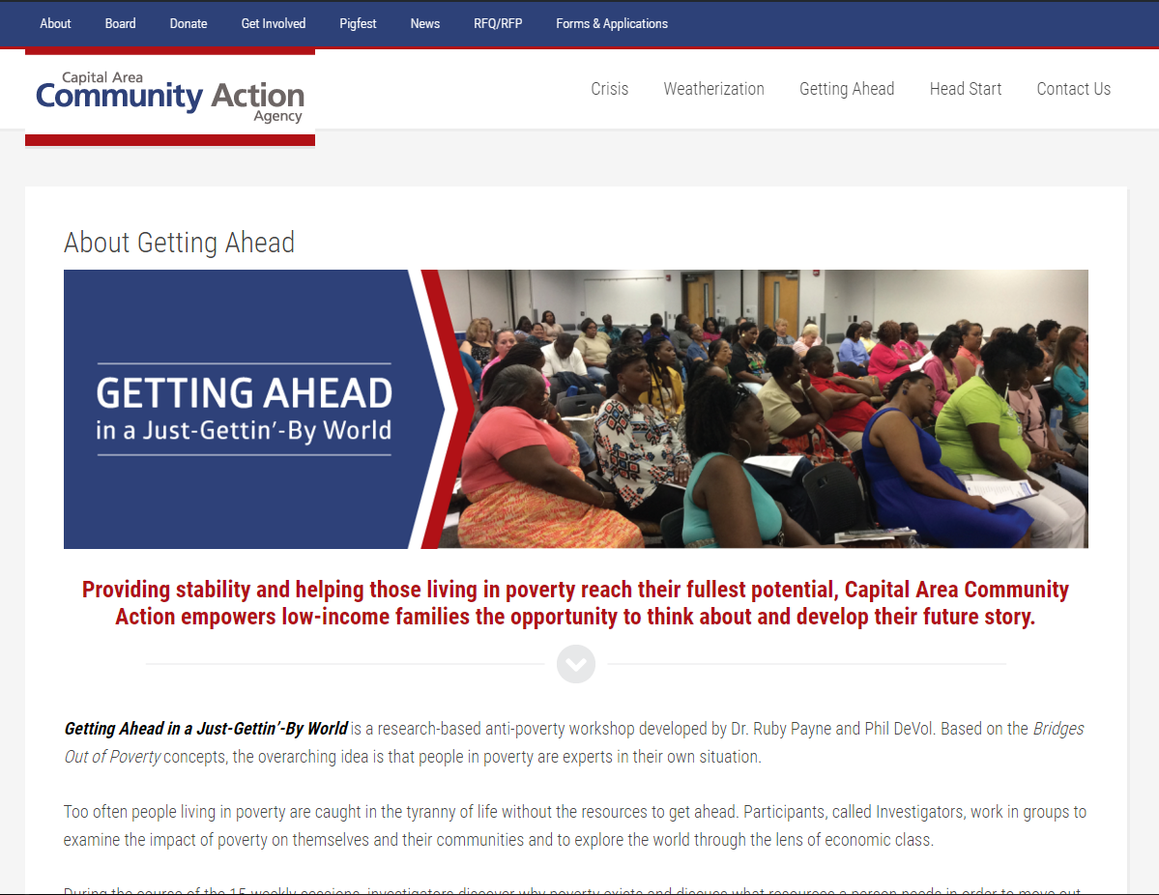
Website

Slide 13
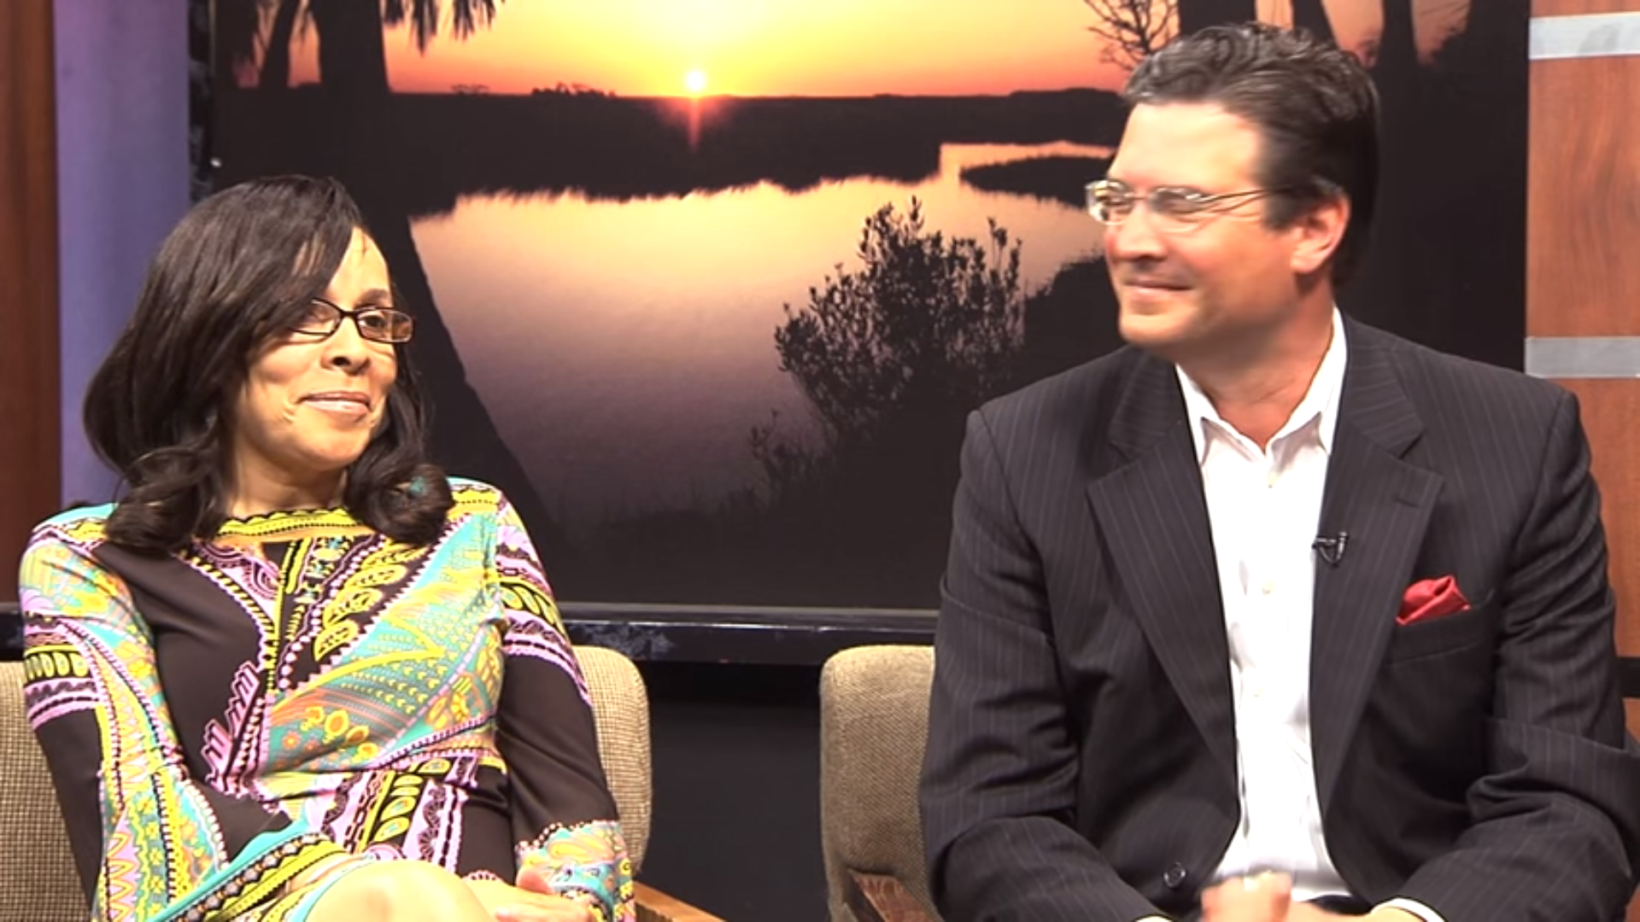
Community News Programming

Slide 14
Social Media

Slide 15
Getting Ahead Documentation

Slide 16
GA/SA Packet
Promotional flyer
Program Information
GA FAQs
GA Application
Sample Interview Questions
Pre- Post-Evaluation
File set-up
GA Overview
SA FAQs
SA Mentor Application

Slide 17
My Life Now Mental Model of Poverty
Notes:
Do mental models of Poverty and balloon exercise simultaneously.

Slide 19
Theory of Change
Abstract: planning ahead
Concrete:
My Life Now
i.e. abuse, neglect, lack of…
9 Steps
Detach
Objectivity
New Information
New Ideas
Analyze
Thinking
Education
Plans
Support
Thinking outside the box
Plans = Actions

Slide 20
The Rich/Poor Gap: Causes of Poverty
Gap

Slide 21
Four Causes of Poverty
Individual Behaviors and circumstances
Community Conditions
Exploitation
Political and Economic Structures

Slide 22
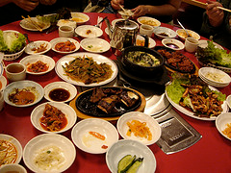
Hidden Rules
POVERTY:
QUANTITY
MIDDLE CLASS: QUALITY
WEALTH: PRESENTATION
Notes:
DO: Handout copy of hidden rules
Hidden rules are the unspoken cues of any group—you either know them or you don’t. If you know them you belong, you don’t know them you don’t belong.

Slide 23
Social Capital
Other Family
Friends
Bonding:
People that help you get by
Household
Work
Agencies
Religious
Bridging:
People that help you get ahead
Schools
Clubs

Slide 24
Self-Assessment
Motivation and Persistence Resource Level
Urgent/Crisis | Vulnerable/ High-Risk | Stable | Safe/Secure | Thriving/ Giving Back
1 | 2 | 3 | 4 | 5
Financial
Emotional
Mental
Language
Social Capital
Physical
Spiritual
Integrity and Trust
Motivation and Persistence
Relationship/Role Models
Knowledge of Hidden Rules
Notes:
Provide them resources scoring chart

Slide 25
Community Assessments/ Building Resources
Schools
Parks
Banks
Local Businesses
Credit Unions
Crisis Intervention Centers
Youth Councils
Notes:
We then begin to build community assessments. Investigators find the individuals, associations and institutions that have the vision, knowledge and connections to help solve community problems in new exciting ways. This creates contacts within the community that help to develop one on one relationship. Participants go into their community and research everything from health conditions, education conditions, jobs and banking conditions.
At this stage investigators who become leaders of their own lives now create their plan. They know what needs to be done, how it needs to be done and where it needs to be done. They have a strategy for building resources for them to achieve their plans.
Combining the relationships-based approach of poverty with the achievement based approach of the middle class allows us to form and build new relationships of mutual respect and expanded opportunities for everyone.

Slide 26
Plans = Actions
MEASURABLE
SPECIFIC
TIME
BASED
REALISTIC
ATTAINABLE
Notes:
This is where you come in.

Slide 27
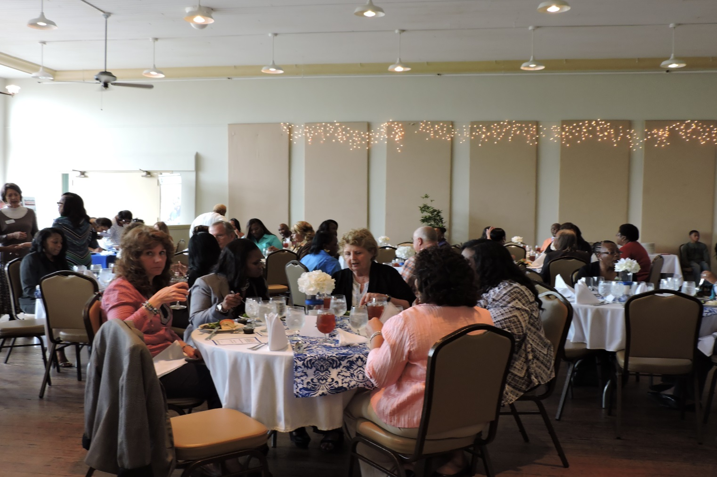
Transition Ceremony

Slide 28
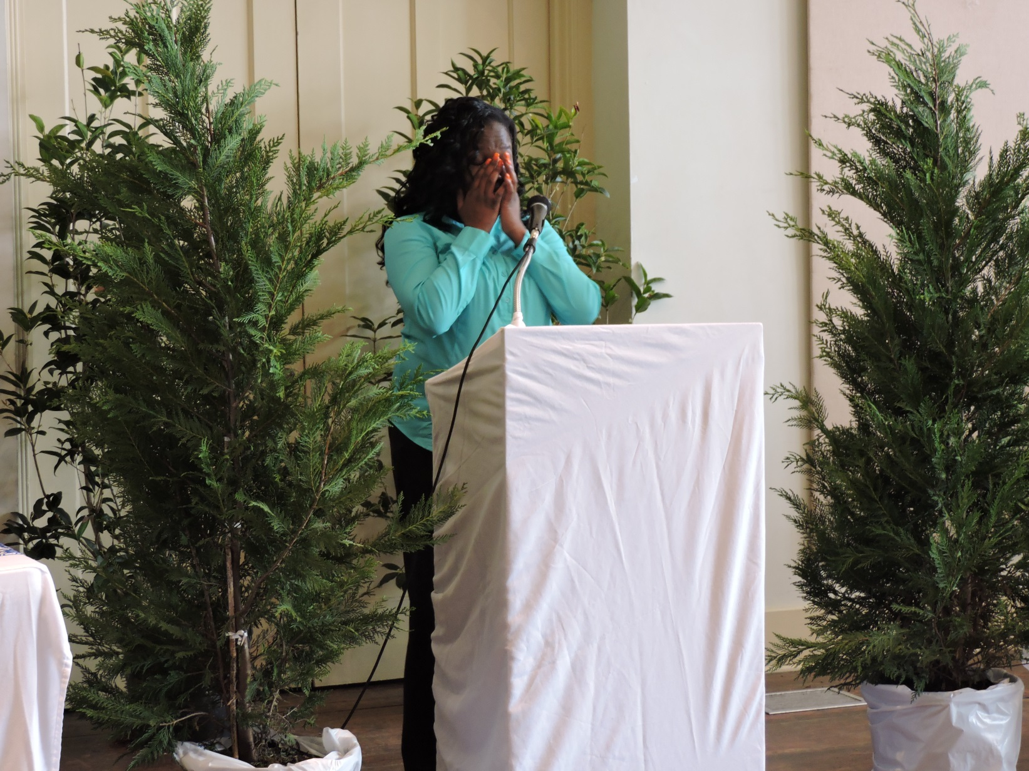

Slide 30
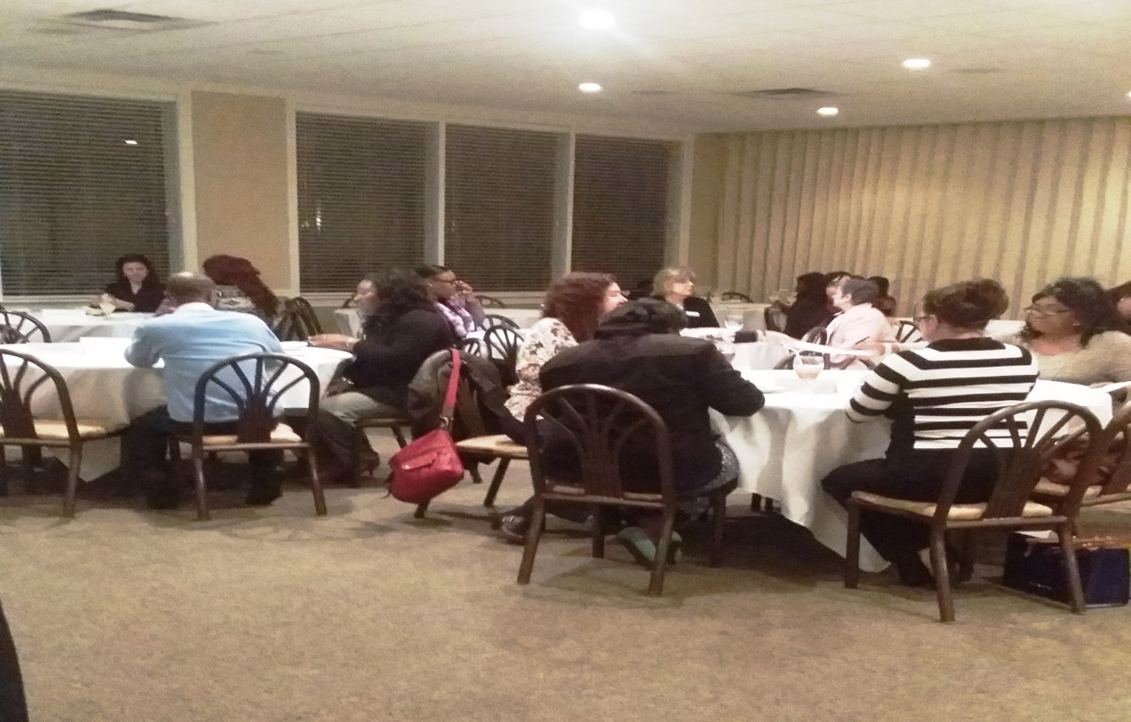
Staying Ahead Mentor Meeting

Slide 31
What is it?
Next phase of Getting Ahead
Matching two mentors with mentee
Developing one on one relationships that will bridge social capital
Increasing the developmental capacity of those most effected by poverty
Encourage upward mobility

Slide 32
What is the role of a mentor?
Mentors provide : emotional support, guidance, motivation, role modeling, and can assist in developing contacts & identifying resources.
Notes:
You have in your packet FAQ’s
Motivation; encouragement to bring out the best in the mentee
Resource broker: providing access to people and resources (community, state, federal) that will support the mentee with achieving upward mobility with their plans. Remember they are aware that agency services keep them in poverty.

Slide 33
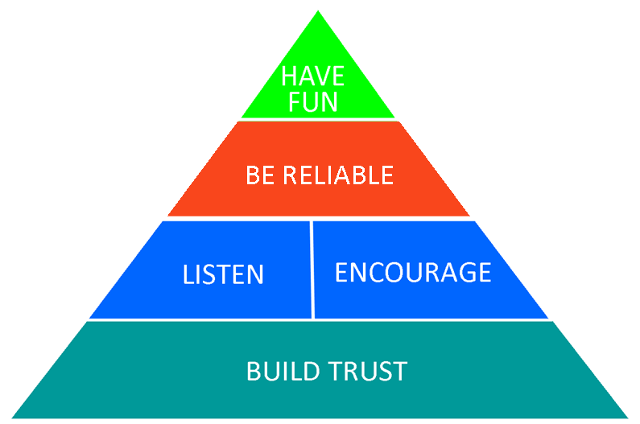
Try new things!
HAVE
FUN
Be consistent
Be persistent
Ask questions
Listen more than you speak
BE RELIABLE
LISTEN
ENCOURAGE
Focus on the positive
Empower vs. enable
Show up
Keep confidence
BUILD TRUST
Oregon Youth Challenge Program. (N.D.) Mentoring Pyramid retrieved 28 March 2015 from http://www.oycp.com/MentorTraining/index.html

Slide 34
B. Time Commitment
Once per month
2 hours
Community Action will provide venue
Each county will be given calendar of dates to meet which will include 1st meeting with mentee.

Slide 35
The meetings will start with a 30-minute workshop
Refreshments will be provided
After the workshop you will have the opportunity to meet with your mentee
Notes:
We are asking if the mentors are interested in running workshops in there area of expertise.
If so there will be a sign up sheet for those interested and please sign up on your way out
Program Coordinator will be in touch with you to scheduling dates

Slide 36
This will be an agency provided opportunity to develop your relationship
The success of the relationship is dependent on constructing meaningful dialogues and designing tangible actions

Slide 37
Financial Assistance
Mentees who request assistance should be directed to case managers
Monetary assistance is not a requirement .
If there is a substantial need seen by mentor please confer with Case Manager

Slide 38
D. Agency Support
Mentors will receive full support Community
Action staff
Mentors will not have to case manage mentees

Slide 39
E. Completion of Mentorship
You may continue relationship with mentee but it is not required
Completion of evaluation
We encourage continual participation
Please refer your friends and colleagues

Slide 40
Questions?

Slide 41
Melissa Watson melissa.watson@cacaainc.org 850.222.2043 x110 http://capitalareacommunityactionagency.com/getting-ahead-facilitators-content/

